Slide 1
Analyze data in a lake database

Slide 2
Introducing lake databases
1
Notes:
TALKING POINTS
Let’s go over how to Ingest Data with Apache Spark Notebooks in Azure Synapse Analytics.
How many of you have used Apache Spark pools in Azure Synapse Analytics, Azure Databricks, Apache Spark, HDInsight?
Talk about an example, of notebooks within the platforms provided.
PRESENTER NOTES AND GUIDANCE
Poll your audience, ask them for examples on data engineering in which they have used a notebook and tried to load data and the products we have to support that, get conversational on the topic, but don’t spend too much time.

Slide 3
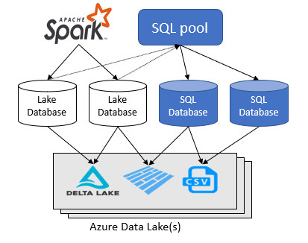
Lake databases
The Azure Synapse Analytics workspace enables you to create two types of databases on top of a Spark data lake:
Lake databases where you can define tables on top of lake data using Apache Spark notebooks, database templates, or Microsoft Dataverse (previously Common Data Service). These tables will be available for querying using T-SQL (Transact-SQL) language using the serverless SQL pool.
SQL databases where you can define your own databases and tables directly using the serverless SQL pools. You can use T-SQL CREATE DATABASE, CREATE EXTERNAL TABLE to define the objects and add additional SQL views, procedures, and inline-table-value functions on top of the tables.
Notes:
Azure Synapse Analytics allows you to create lake databases and tables using Spark or database designer, and then analyze data in the lake databases using the serverless SQL pool. The lake databases and the tables (parquet or CSV-backed) that are created on the Apache Spark pools, database templates, or Dataverse are automatically available for querying with the serverless SQL pool engine. The lake databases and tables that are modified will be available in serverless SQL pool after some time. There will be a delay until the changes made in Spark or Database designed appear in serverless.
Use SQL database to connect to external file sources using other auth methods like SAS tokens. Lake database only supports Azure AD (Entra ID) authentication on the data lake and Dataverse.

Slide 4
LAB 4: Analyze data in a lake database
60 minutes
Notes:
TALKING POINTS​
​
Let’s put this into reality and show you how it works.​
​
All instructions and context are found in this repository​

Slide 5


Conference workshop presentations
Solliance Training
https://aka.solliance.net/azure-de-workshop
https://training.solliance.net

